Slide 1

WEB PROJECT
PROPOSAL
Information Technology Project-2021
Year 2 Semester 2
ITP2021_S2_B01_G04

Slide 2
TABLE OF CONTENTS
01
04
INTRODUCTION
TOOLS AND TECHNOLOGIES
02
05
SYSTEM OVERVIEW
WORK DISTRIBUTION
03
06
FUNCTIONS
PROJECT MANAGEMENT PLAN
ABOUT COMPANY, OBSTACLES, SOLUTIONS AND BENEFITS
SYSTEM DEVELOPING ENVIRONMENTS
AN OVERVIEW AND A SNEAK PEAK ON THE SYSTEM
TEAMWORK
AN EXPOSITION ABOUT SYSTEM FUNCTIONS
A GATT CHART ON FUTURE PLANNING

Slide 3
INTRODUCTION

Slide 4

OUR COMPANY
OCADO is a product items delivery management company, which act as an intermediate interface between buyers and sellers who are dealing with grocery items, homewares, households and fresh food based in Sri Lanka.

Slide 5
ABOUT THE PROJECT
Buyers can make orders from their preferred supplier.
Suppliers will provide the certain order with highly efficient delivery staff employed by OCADO.
OCADO systems will maintain several warehouse storages across the country.
Reliable return and refund policy.

Slide 6
OBSTACLES
LOW EXPANSION
UNNECESSARY MOBILITY
PHYSICAL PAYMENTS
POOR STORAGES
FAST TECH GROWTH

Slide 7
SOLUTIONS
BRANDING
GOAL ORIENTED DELIVERY
CONTACTLESS PAYMENT
STANDARD WAREHOUSES
EASY TO USE APP

Slide 8
BENEFITS
SECURE
ACCESSIBLE
FAST AND RELIABLE
The privacy of the users are in responsible hands
Can access the app without any interruption
A Convenient use without bugs and errors. Well trained drivers.

Slide 9
BENEFITS
EXPANSION
POSITIONING
USABILITY
Availability across Sri Lanka and possible foreign entities.
High quality warehouse storage will keep the standard, uniqueness and competitiveness.
Anyone can use the app without a huge amount of technological knowledge.

Slide 10
2. SYSTEM OVERVIEW

Slide 11
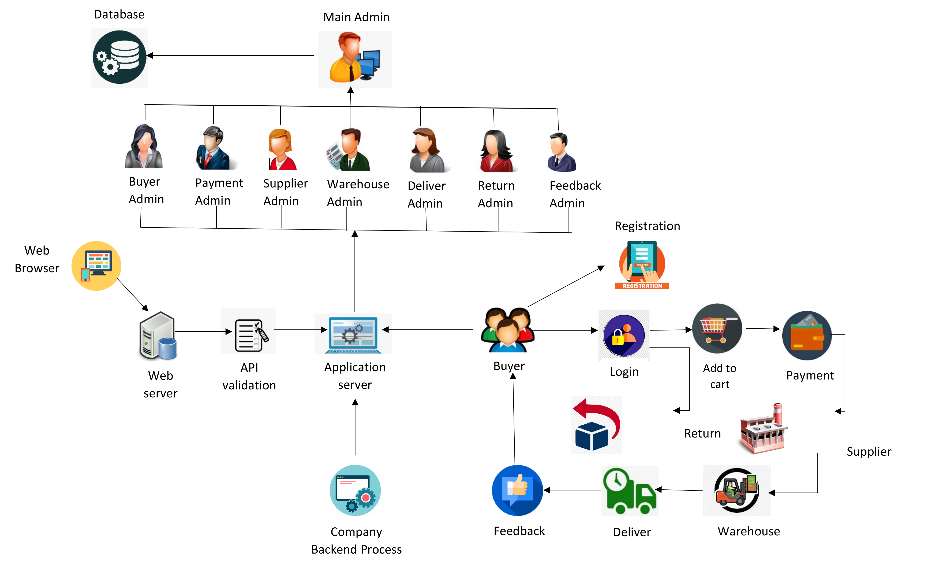
OVERVIEW

Slide 12
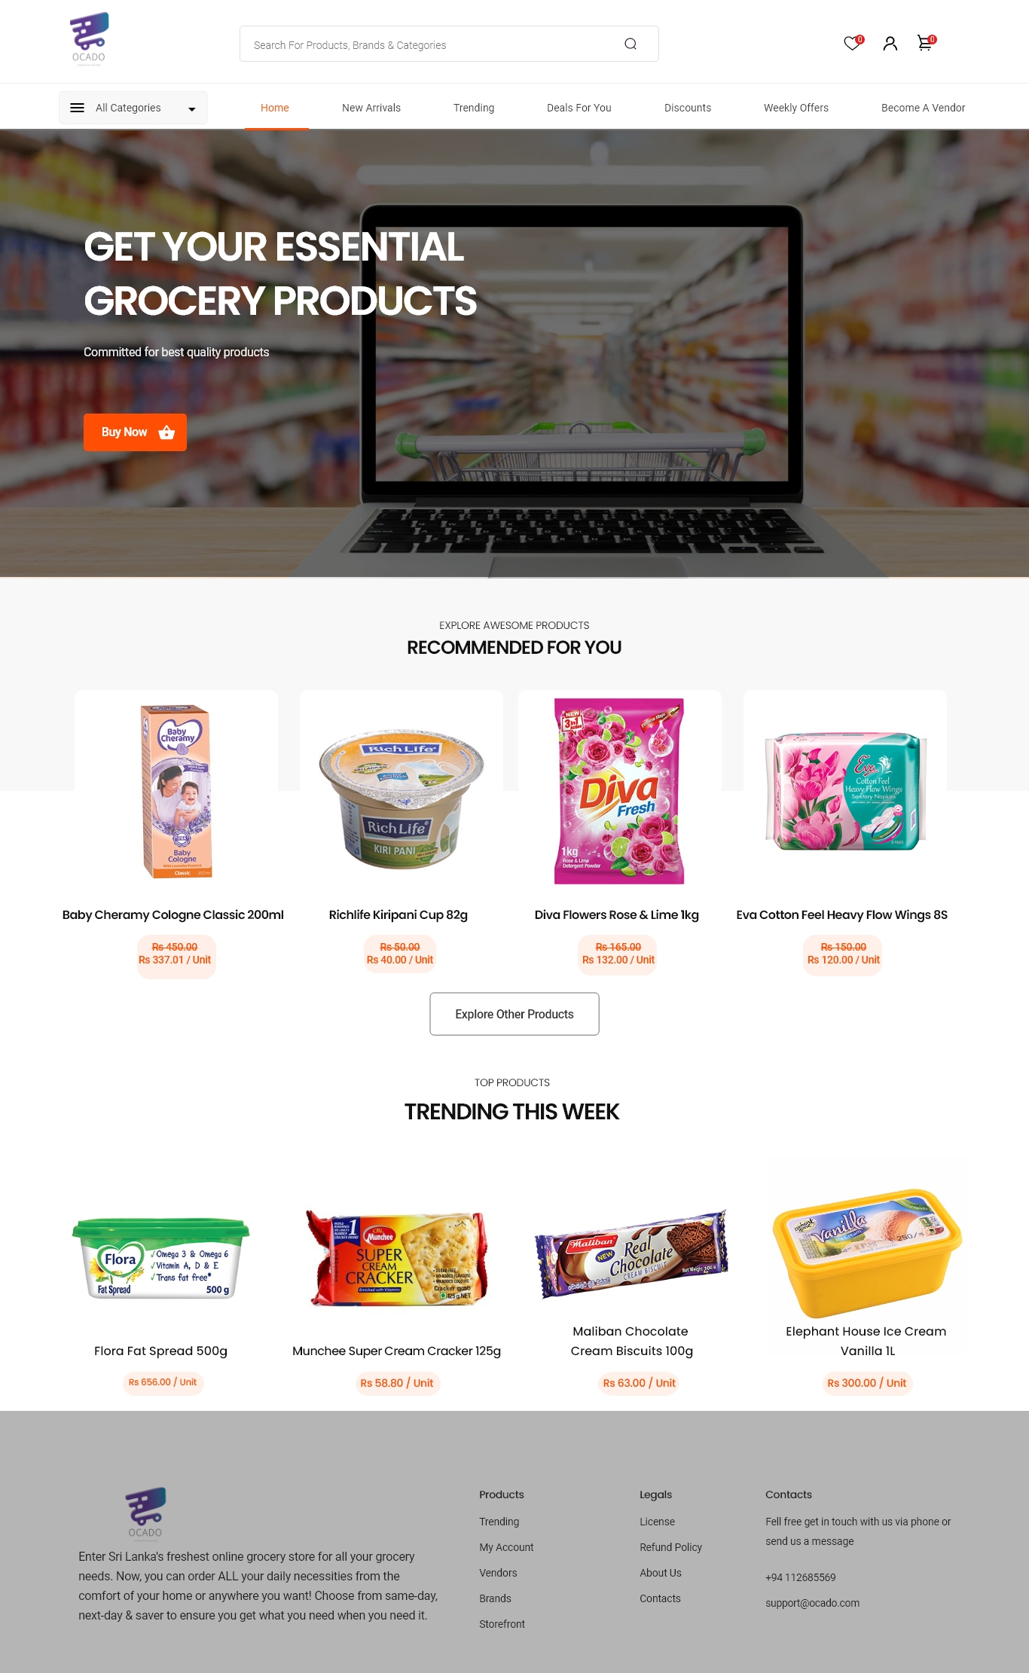
SNEAK PEEK

Slide 13
3. FUNCTIONS

Slide 14
FUNCTIONS
BUYER
MANAGEMENT
RETURN &
REFUND
MANAGEMENT
FEEDBACK
MANAGEMENT
PAYMENT &
FINANCIAL
MANAGEMENT
DELIVERY
MANAGEMENT
ADMIN PANEL
MANAGEMENT
SUPPLY
MANAGEMENT
WAREHOUSE
MANAGEMENT

Slide 15
BUYER MANAGEMENT
Buyer Side
Buyer can enter their personal details for the registration form
Buyer can login to the system by giving the credentials as username and password
Buyer can have the opportunity to reset (update) the password
Buyer can view the user profile and even though he can update the details or delete the user account
In add to cart page buyer can add(insert) product items to the cart
The entered items quantity can be change(update) or the product item can be removing (delete) through the cart

Slide 16
BUYER MANAGEMENT
Buyer Admin Side
Admin can login to the admin panel by giving the username and password
In the database admin create the login table, registration table and cart table
For these table admin can insert details, update details or delete them
By using the login details, registration details and add to cart details he can generate the monthly report
Admin can create the search function by using the registration id and cart id
In additionally, create the home page and inside of that create contact us, registration policies and about us details

Slide 17
PAYMENT & FINANCIAL MANAGEMENT
Collects user data via Payment Information checkout.
Allows user to update/delete data.
Card insertion and Card validation.
Handles monthly wages and transaction databases.
Transaction history and Monthly report.

Slide 18
SUPPLY MANAGEMENT
Supplier registered to the system by filling a registration form.
Login to the system by entering login credentials.
Then supplier can view his profile, insert product items, view orders.
Supplier can add new items, update or remove added items any time.

Slide 19
SUPPLY MANAGEMENT
Admin create an inventory which is only visible for admin panel management.
Admin will calculate total of orders and assign them to supplier.
Notify warehouse about orders.
Generate monthly report on summarization of orders.

Slide 20
WAREHOUSE MANAGEMENT
Without warehouse
Interrupt 3 times
Or more
With warehouse
Interrupt only 1 time

Slide 21
WAREHOUSE MANAGEMENT
Display the current orders to be assembled
Track the incoming products to the warehouse
Display the current products available in the warehouse
Track the departure packages from the warehouse
Reports can be generated for
Incoming Products
Current products available in the warehouse
Departed packages
Product's information can be searched via PackageID and ProductID in case of complaint about misplacement.

Slide 22
DELIVERY MANAGEMENT
Drivers can register to the system through filling the application form.
Registered drivers could login to the system through login credentials.
Once logged in, drivers could check the task list applicable to his profile such as orders to be delivered and delivery history.
Delivery Admin should assign each order to available drivers to make it delivered.
Delivery Admin should calculate the delivery distance and delivery fee based on the order details.
Delivery Admin should generate daily and monthly reports containing the details of deliveries made.
Delivery Admin should notify Main Admin regarding the deliveries made daily.

Slide 23
RETURN & REFUND MANAGEMENT
Buyer Side
Login to the return or exchange page by using Order ID and Email.
After moving on returning request page, buyers can insert Personal information, Product information, return reasons and delivery details into the form.
If the buyer wants to edit some details, he can update it through the form.
Sometimes, If the buyer wants to cancel (delete) the request, he can apply for the cancellation form within a week.

Slide 24
RETURN & REFUND MANAGEMENT
Return & Refund admin side
Return and refund admin can log in to the admin panel by using username and password.
Admin can do the refunding to the buyer through the refund page and there is no refunding within the exchange product item.
Admin can request return or exchange the product items in warehouse to the suppliers using product details, order details and delivery details. And admin can update or delete that request details.
Admin can insert all the return, exchange, and refund details into the database.
Admin can update or delete that entered details in database.
Admin provide a monthly report using that return, exchange, and refund details
Admin can create search function for searching database details using business ID, Order ID, request ID, refund ID, cancellation ID etc.
In addition, create a return & refund policy page.

Slide 25
FEEDBACK SYSTEM MANAGEMENT
Buyer can insert feedback for each product after he/she brought it.
Every site visitor can see feedback for each product.
Buyer can edit his feedback which was created by him/her.
Buyer can delete his feedback which was created by him/her.
Buyer can open ticket if he/she got any issue relating OCADO side.

Slide 26
FEEDBACK SYSTEM MANAGEMENT
Buyer can see his/her ticket status according to his/her ticket.
Buyer can edit his ticket details which he created.
Admin can remove ticket after issue was resolved.
Buyer can navigate best selling product based on buyer feedback.

Slide 27
ADMIN PANEL MANAGEMENT
Add head admin to the system.
Update the details of the head admin
Create the admin panel.
Create the registration and login for function admins.
Update the details of the admins.
Remove admins when needed.

Slide 28
ADMIN PANEL MANAGEMENT
Create the inventory form for insert the inventory
develop the Update and delete function for inventory.
Create the home page with a search bar to search any items in the system.
In addition, create the newsfeed, such as news insertion ,update and delete.
Reports can be generated for
*Admin list
*Monthly report on items

Slide 29
4. TOOLS AND TECHNOLOGIES

Slide 30



TOOLS & TECHNOLOGIES
UML TOOLS AND TECHNIQUES: Microsoft Office, Draw.io, StarUML, Mockflow.
DATABASE MODELING TOOLS: MongoDB
PROJECT MANAGEMENT: MS Project

Slide 31





IMPLEMENTATION
PROGRAMMING LANGUAGE: JavaScript ; Node.js
FRAMEWORKS: React.js
WEB TECHNOLOGIES: Bootstrap, HTML, XML, CSS
WEB SERVER: Apache tomcat
IDE: Visual Studio Code, Sublime Text, Eclipse
DATABASE: MongoDB
CLOUD COMPUTING: Private Cloud

Slide 32
5. WORK DISTRIBUTION

Slide 33








THE TEAM
ASHANI ISURIKA
MANUL MANDALAWATTA
DULANGA KANDANAARACHCHI
MALEESHA FERNANDO
CHALANKA JINADASA
KANJANA EPITWATTA
VIBHU JAYAWARDANE
BIHINI AMARASINGHE

Slide 34
WORK DISTRIBUTION
STUDENT ID | NAME WITH INITIALS | FUNCTION
IT20187828 | ISURIKA M.D.A. | SUPPLY MANAGEMENT
IT20085094 | EPITWATTA E.A.E.K. | ADMIN PANEL MANAGEMENT
IT20074654 | FERNANDO W.A.M.A.R. | BUYER MANAGEMENT
IT20115548 | JINADASA U.G.O.C. | WAREHOUSE MANAGEMENT
IT20157500 | KANDANAARACHCHI H.L.D.S. | DELIVERY MANAGEMENT
IT20174330 | JAYAWARDANE W.M.A.V. | PAYMENT & FINANCIAL MANAGEMENT
IT20120016 | AMARASINGHE B.P.A. | RETURN & REFUND MANAGEMENT
IT20163754 | MANDALAWATTA M.T. | FEEDBACK SYSTEM MANAGEMENT

Slide 35
6. PROJECT MANAGEMENT PLAN

Slide 36
OUR TIMELINE
JULY
SEPTEMBER
CLIENT
FINAL
VERSION
AUGUST
OCTOBER
Initialization
Implementation
Development
Progress review

Slide 37
GANTT CHART
TASK | JULY |  |  |  | AUGUST |  |  |  | SEPTEMBER |  |  |  | OCTOBER
FINDING A CLIENT
GATHERING REQUIREMENTS
REQUIRENMENT ANALYSIS
FUNCTIONALITIES
CHARTER APPROVAL
SCRUM ACTIVITY
PROPOSAL PRESENTATION
UI SKETCH
CONCEPTUAL DATABASE
PHYSICAL DATABASE
IMPLEMENTATION
SYSTEM TEST
FINAL REPORT

Slide 38
THANKS!
Does anyone have any question?
addyouremail@freepik.com

